Slide 1

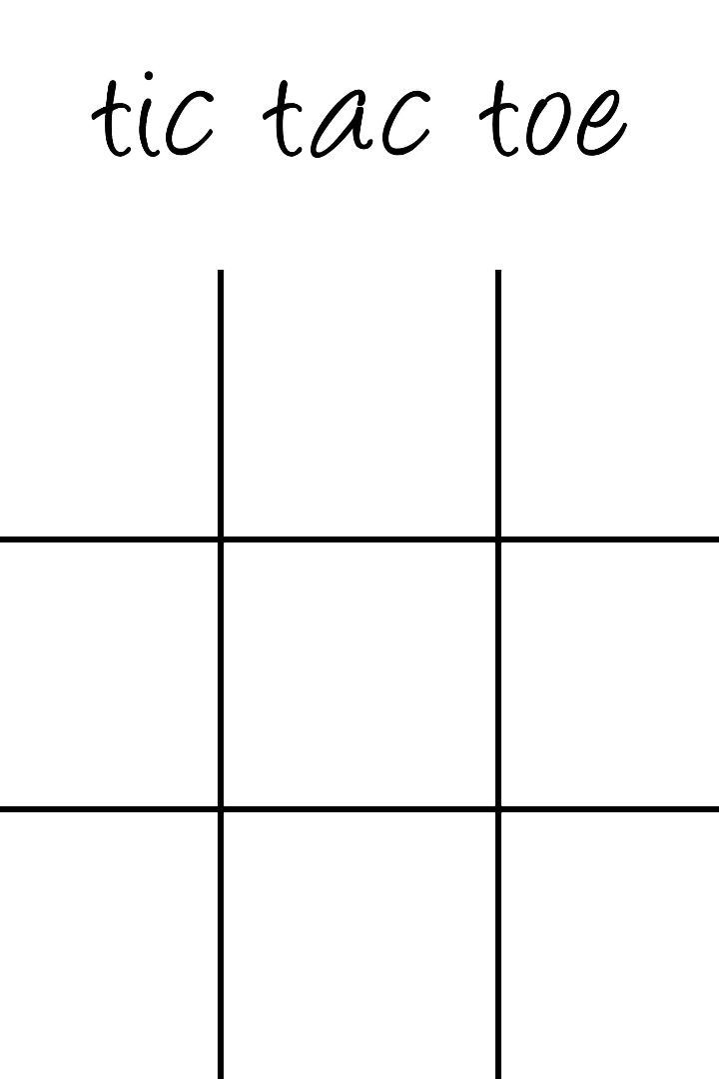

Tic Tac Toe with HTML, CSS, and Javascript
By Dev Garg
2110992537

Slide 2

Tic Tac Toe Game Rules
1
Setting up the Board
2
Playing the Game
3
Winning Conditions
Take turns selecting a cell to place your marker (X or O).
A player wins by having three of their markers in a row (horizontally, vertically, or diagonally).
Create a 3x3 grid using HTML tags to represent the game board.

Slide 3
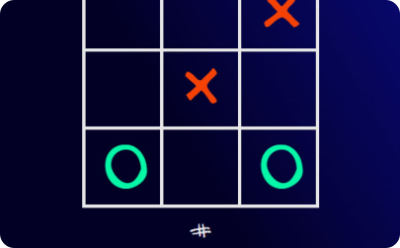

Implementing the Board Structure
Construct the tic-tac-toe grid in HTML using nested div elements with unique IDs assigned to each cell.
HTML Grid
CSS Styling
Javascript Interactivity
Create a 3x3 grid using nested div elements to represent the tic-tac-toe board.
Apply CSS styles to the HTML grid to give it a visually appealing appearance.
Add event listeners with jQuery to handle player moves and game logic.

Slide 4

Mastering Tic Tac Toe with CSS
1
Board Styling
Create an attractive and user-friendly design with CSS for the tic-tac-toe board.
2
Marker Styling
Customize the X and O markers with CSS to make them visually appealing.
3
Hover Effects
Add hover effects to the cells to enhance the user experience during gameplay.

Slide 5

Adding Interactivity with jQuery
Utilize the power of javascript to enhance the user experience and implement game logic such as checking for a win or a draw.
Event Listeners
Attach click event listeners to each cell to detect player moves.
Game Logic
Write functions to check for winning conditions and update the game state accordingly.
Dynamic Updates
Use javascript to dynamically update the display and provide real-time feedback to the players.

Slide 6

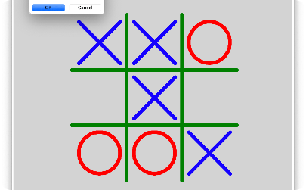
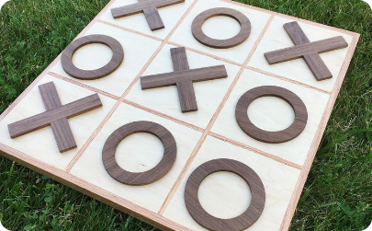
Take Your Tic Tac Toe Game Further
Multiplayer Mode
AI Opponent
Custom Themes
Expand your game to support multiple players for an exciting multiplayer experience.
Create an AI opponent using jQuery to challenge players and improve their skills.
Allow players to choose from a selection of visually appealing themes for a personalized experience.

Slide 7
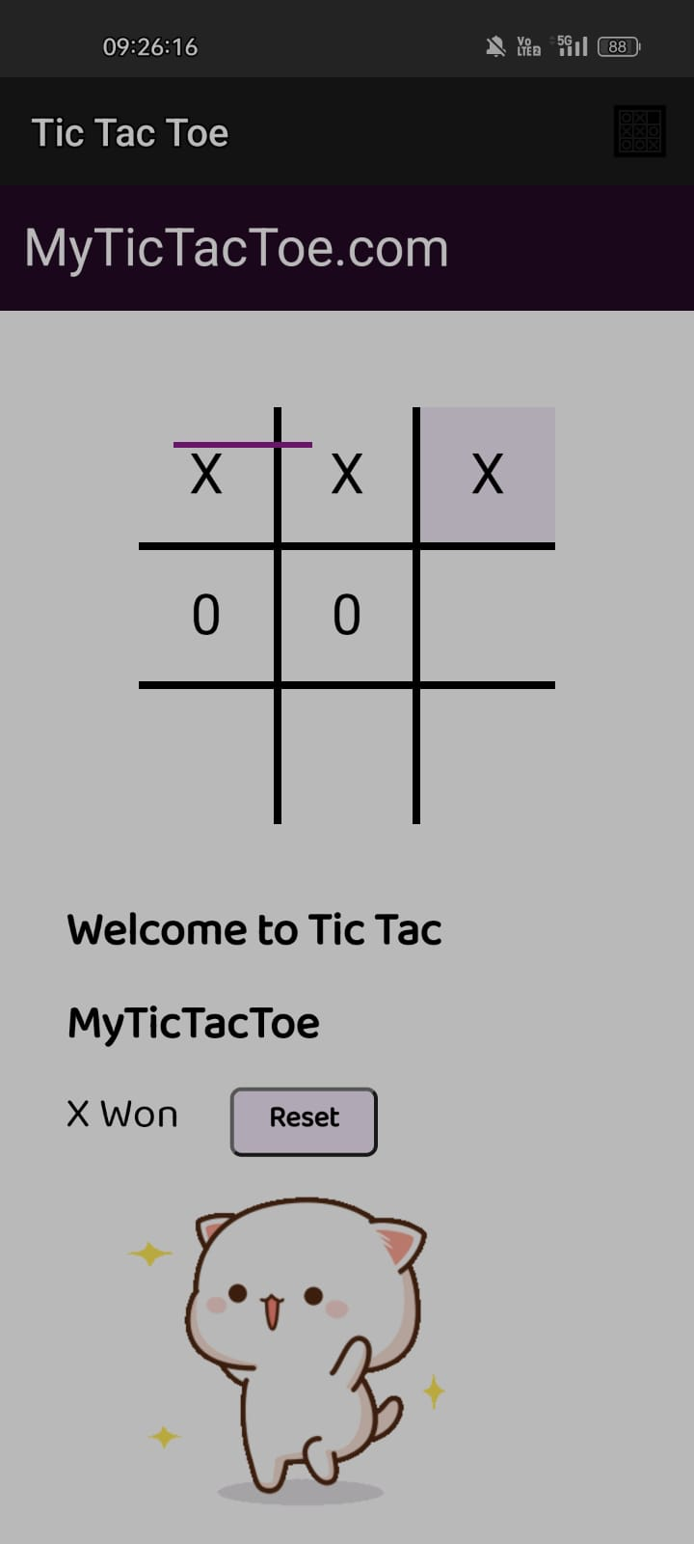

Slide 8

Conclusion
By developing a Tic Tac Toe game using HTML, CSS, and javascript, you will gain valuable insights into web development fundamentals and enhance your programming skills. Start coding your own game today!

